Slide 1
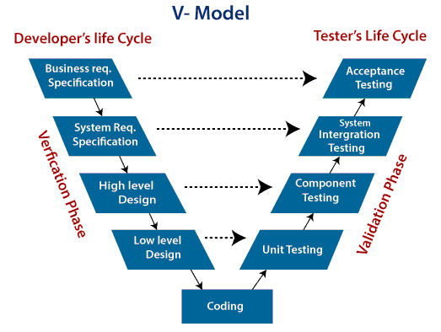
Software Development Life Cycle
V – Model
V-Model also referred to as the Verification and Validation Model.
It is the extension for Waterfall Approach
Testing is Associated with every stage of the project
Verification: It is the process of evaluation of the product development process to find whether specified requirements meet.(Before Development of Code)
Validation - Validation is the process to classify the software after the completion of the development process to determine whether the software meets the customer expectations and requirements. .(After Development of Code)
Sandeep Bandaru

